Slide 1


Intro to J2ME
Taken from Vidya Setlur’s Course on Java
5 – Gaming (Part 2)
Nathan Eagle, PhD
Research Scientist
MIT Design Laboratory
Massachusetts Institute of Technology
April 2007
GSTIT, Addis Ababa, Ethiopia

Slide 2
Recap:
Last class we talked about using a GameCanvas to render a static image.
We used TiledLayer to create a background.
We used keys to move the image about the screen.

Slide 3
Sprites
To display a game element you can use an image.
A sprite is a term in the game world that refers to any visual element, usually an animated image, that can be moved around the screen independently of the other elements.
The Sprite class is used to represent sprites in the MIDP 2.0 gaming API.
The class provides methods to animate the sprite from a handful of images, similar to the way backgrounds are created using the TiledLayer class.
It also provides methods to check collisions with other game elements, including images, sprites, or tiled layers.

Slide 4
Sprite Frames
The raw frames used to render a Sprite are provided in a single Image object.
If more than one frame is used, the Image is broken up into a series of equally-sized frames of a specified width and height.
The set of frames may be stored in several different configurations.
Each frame is assigned a unique index number starting from 0. Numbering is row-major (indices are assigned across the first row, then the second row, and so on).

Slide 5
Creating a Sprite
The Sprite class requires that the size of each frame be passed in to its constructor.
pokemonSprite = new Sprite(pokemonImg, 28, 36);
Create a sprite with two frames of 28 X 36 pixels each, numbered from 0 onwards.
nextFrame() gets the next frame in the set.
You can set a particular frame to be displayable in a sequence using
setFrame(int sequenceNo).

Slide 6
Positioning a Sprite
Before the sprite can be rendered on the canvas, you need to define a reference pixel for it.
This is the origin around which all painting operations are done. By default, a sprite is painted with its upper left corner as its origin.
coupleSprite.defineReferencePixel(int x, int y);

Slide 7
LayerManager
A game may contain at least one TiledLayer for background and several Sprite classes for individual movable game pieces.
The LayerManager provides methods to add, remove, or insert layers from a game, and also provides a single method to paint all of these layers to the underlying Graphics object. So you really don’thave to call paint() method of each of the layers of a game.
An instance of LayerManager is created using its zero argument constructor. Layers are then added, removed, or inserted into it by using the methods append(Layer layer), remove(Layer layer), and insert(Layer l, int index).
The layer at index 0 is painted on top of all the other layers, and hence, is closest to the user.

Slide 8
Creating a LayerManager
// create the layermanager
layerManager = new LayerManager();
// add layers layerManager.append(pokemonSprite);
// create the game background generateGameBackground();
layerManager.append(background);

Slide 9
Timer Class
If you need to keep track of time during the game to either move to the next level or stop you would have define your own Game Timer class.

Slide 10
import java.util.TimerTask;
public class GameTimer extends TimerTask {
int timeLeft;
public GameTimer(int maxTime) {
timeLeft = maxTime;
}
public void run() {
timeLeft--;
}
public int getTimeLeft() {
return this.timeLeft;
}
}

Slide 11
Using the Timer
Before entering the infinite loop do:
// To set timer for 60 seconds
gameTimer = new GameTimer(60);
Schedules the specified task for repeated fixed-delay execution, beginning after the specified delay. In fixed-delay execution, each execution is scheduled relative to the actual execution time of the previous execution. If an execution is delayed for any reason (such as garbage collection or other background activity), subsequent executions will be delayed as well. Fixed-delay execution is appropriate for recurring activities that require "smoothness." In other words, it is appropriate for activities where it is more important to keep the frequency accurate in the short run than in the long run. This includes most animation tasks, such as blinking a cursor at regular intervals.
Parameters:
    task - task to be scheduled.
    delay - delay in milliseconds before task is to be executed.
    period - time in milliseconds between successive task executions.
new Timer().schedule(gameTimer, 0, 1000);

Slide 12
Spawning New Sprites
Create a new Sprite class that implements Runnable, as it needs to spawn several new sprites every x seconds.
Call run() method to randomly create sprites after sleeping for x milliseconds.
Usually before spawning new sprites you need to check if the number of sprites already on the canvas is not over the limit (else you will have overcrowding!).
Then calculate a random position for this sprite to appear at, making sure that this random position is within the game play area.
Set the newly created sprite in this random position and adds the sprite to the LayerManager at index 0, so that it becomes the most recent (and closest to the user) sprite.

Slide 13
The Fun Part:
Checking for Collisions
Use the collidesWith() method of the Sprite class to check for collision.
This method returns a Boolean true when collision has occurred, and accepts a layer, an image, or another with which sprite to check collision.
It also accepts a flag to indicate if collision detection should take into account the transparent pixels around an image, or only opaque pixels.

Slide 14
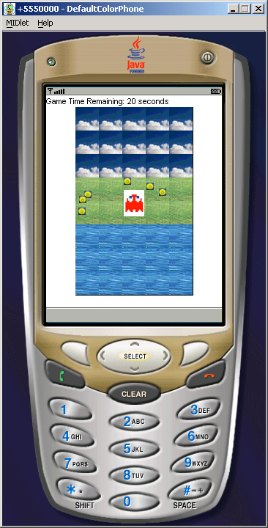

Slide 15
In-Class Exercise
Task 1: Add point weighting such that using certain keys more balls can be hit.
Task 2: Interchange the collision behavior such that the balls can make Pokemon disappear.

Slide 16
Homework
Develop a first-person J2ME Pacman game.
Pac-Man has a big appetite. As you guide the yellow, pie-shaped character around a maze in the game, he gobbles up the dots lining the pathways. If he eats one of the four ‘Power Pellets’ in each corner of the maze, he can devour the one of the four ghosts that are in constant pursuit.
Game over if Pac-man either reaches ‘home’ or is gobbled up by the ghosts or time expires.

Slide 17
Assignment Points
How well you create the playfield and characters.
Animation has to be provided to Pacman as he gobbles up dots and the ghost.
Animation has to be provided if the ghost gobbles up pacman.
Game logic.
Display score at the end.
Extra credit to interesting game logic and special effects.

Slide 18
Game References
http://www.palowireless.com/java/games.asp
http://www.midlet-review.com/index?content=freegames/freegames
Game Optimization: http://www.microjava.com/articles/techtalk/optimization

